Slide 1


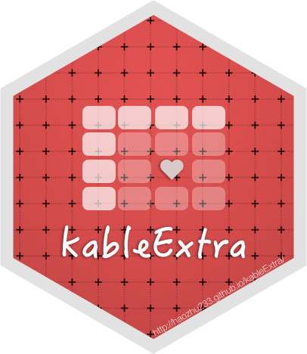
publication ready tables in R
(gtsummary, RMarkdown, kableExtra)
A.Sadiq

Slide 2
Agenda
Conduct Expectations
Learning Aims
Examples
Dataset Meet and Greet
Getting to Business
Summary stats, p-values, and descriptive statistics with tbl_summary()
Summarize regression results with tbl_regression & tbl_uvregression
Joining multiple tables and tests with tbl_merge & tbl_stack
Modifying aesthetics
Exit Goal: Compile a R sheet or Rmd file with a descriptives table and test statistics of your chosen dataset

Slide 3
Code of Conduct & Learning Expectations
Every person, voice, background, and perspective is welcome!
Its okay to not know!
Solution 1: Look things up (Help Documentation, R for Data Science, Stack Overflow)
Solution 2: Ask for help (Aishat, Jacob, tablemates)
Try and try and try and try and try and try again!
Use data science for good, not evil
If using Zoom: Feel free to add questions to the chat, turn on/off your camera, and change your zoom name to include your pronouns!

Slide 4
Learning Aims
• Practice editing the aesthetics of a table (titles, font size, etc)
• Produce a descriptive statistics table using publication format for a relevant journal
• Turn an analysis output (eg. Regression, t-test, anova) into a publication ready
table

Slide 5
Why do we care about pretty tables in research?

Slide 6
Why do we care about pretty tables in research?
Reproducible results!!
Notes:
Alternative Question: Why did you show up for this workshop today?

Slide 7
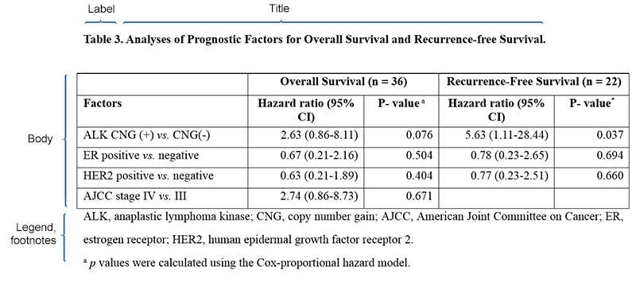
Examples

Slide 8
Choose your dataset!
Option 1 - Determinants of Murder Rates in the United States
Option 2 - Weight Data for Domestic Cats
Option 3 - Impact of Beauty on Instructor's Teaching Ratings
Option 4 - Number of Equations and Citations for Evolutionary Biology Publications
Spend 5 minutes introducing yourself in your groups

Slide 9
Here’s what you can do with gtsummary
Summarize data frames or tibbles to present descriptive statistics, compare group demographics (e.g creating a Table 1 for medical journals), and more!
Summarize regression models. Using broom::tidy() in the background, gtsummary plays nicely with many model types (lm, glm, coxph, glmer etc.). You may also use custom functions to summarize regression models that do not currently have broom tidiers.
Customize gtsummary tables using a growing list of formatting/styling functions: everything from which statistics and tests to use to how many decimal places to round to, bolding labels, indenting categories and more!
Report statistics inline from summary tables and regression summary tables in R markdown. Make your reports completely reproducible!
Leverage compatibility with multiple R Markdown outputs to create beautiful, reproducible reports in a variety of formats (HTML, PDF, Word, RTF)

Slide 10
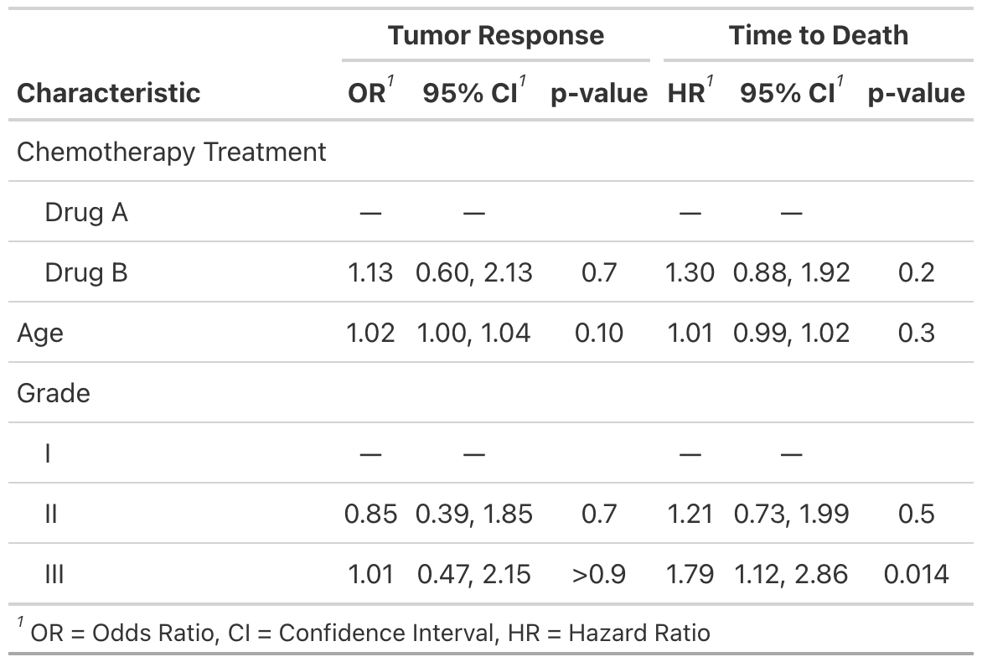
Here’s what we will do with gtsummary
Summarize data frames or tibbles
Summarize regression models
Customize gtsummary tables
Report statistics inline from summary tables and regression summary tables in R markdown. Make your reports completely reproducible!
Leverage compatibility with multiple R Markdown outputs*

Slide 11
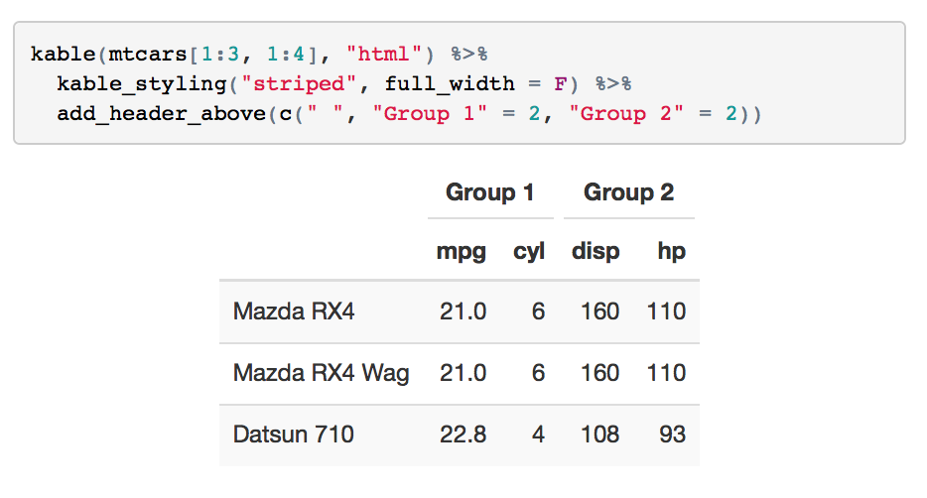
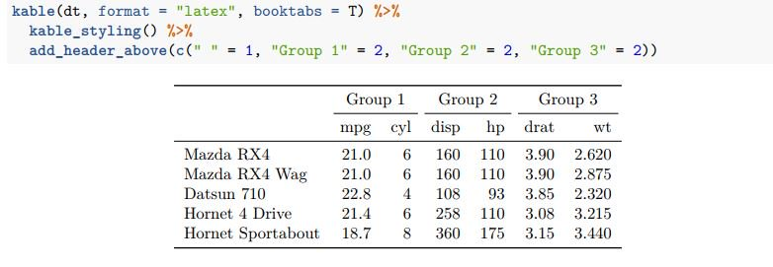
Here’s what you can do with kableExtra
Summarize data frames or tibbles
Summarize regression models
Customize HTML tables
Notes:
Ask if they know the pipe operator (%>%)

Slide 12
Have you seen me?
Notes:
Ask if they know the pipe operator (%>%)

Slide 13
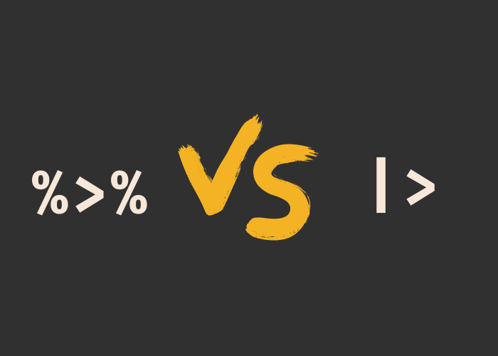
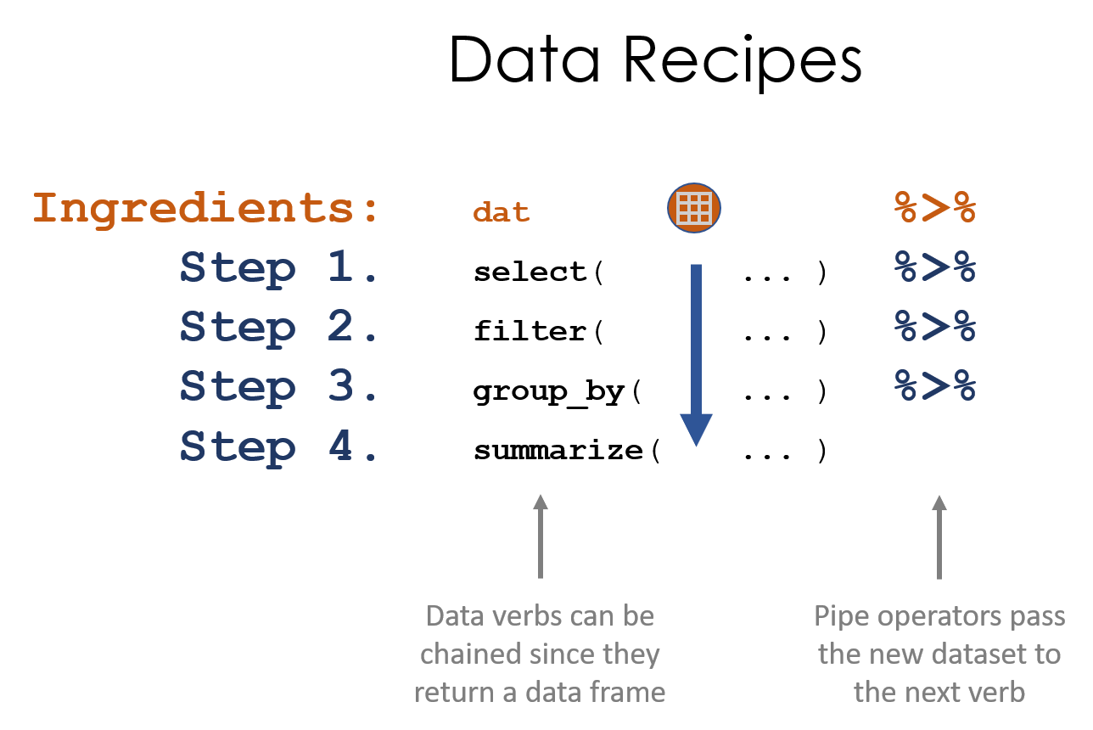
Pipe Operator
Notes:
Ask if they know the pipe operator (%>%)

Slide 14
Summary Stats & Demographics Tables
R Code
Discussion Question: What does the data say? Who would most benefit from this analysis and your conclusions and recommendations? Who might be most harmed?

Slide 15
Summarize regression results with tbl_regression & tbl_uvregression
R code

Slide 16
Joining multiple tables and tests with tbl_merge & tbl_stack
R code

Slide 17
Modifying aesthetics
R code

Slide 18
Vocabulary
packages
pipe operator %>%
<- vs =

Slide 19
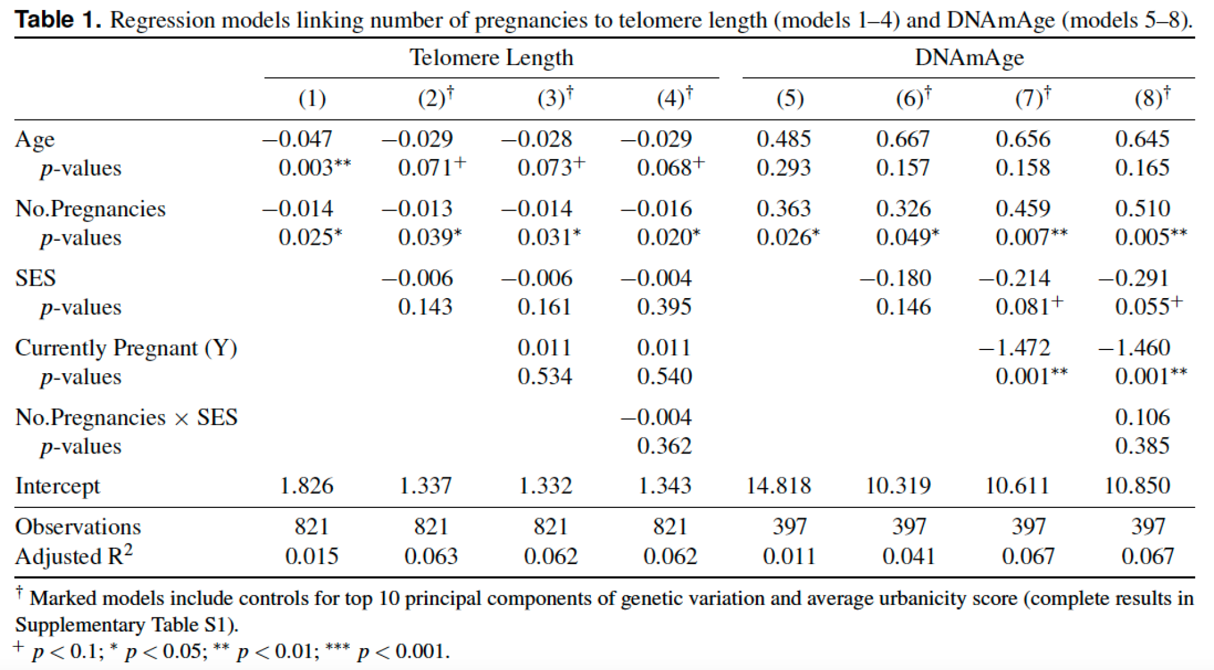

Slide 20
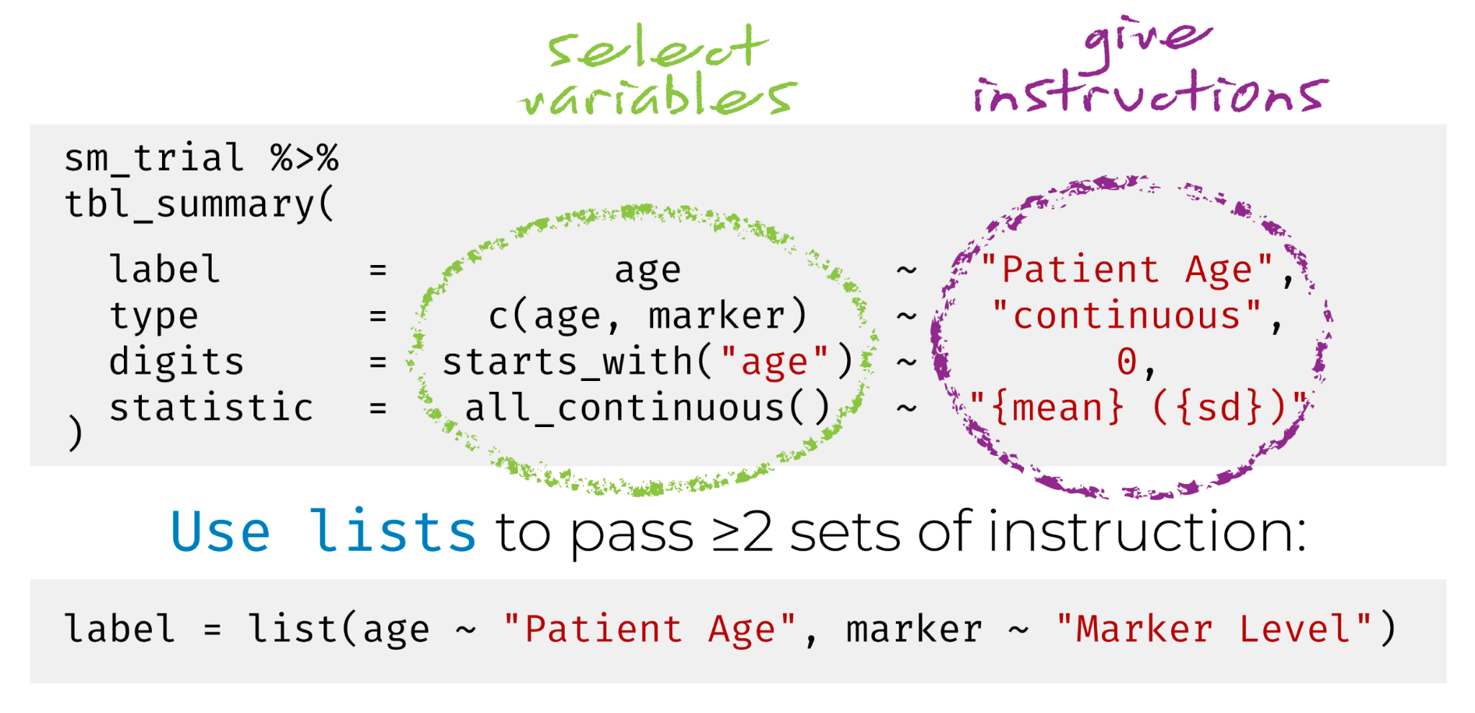

Slide 21
Flash Group Presentations

Slide 22
Junkyard

Slide 23
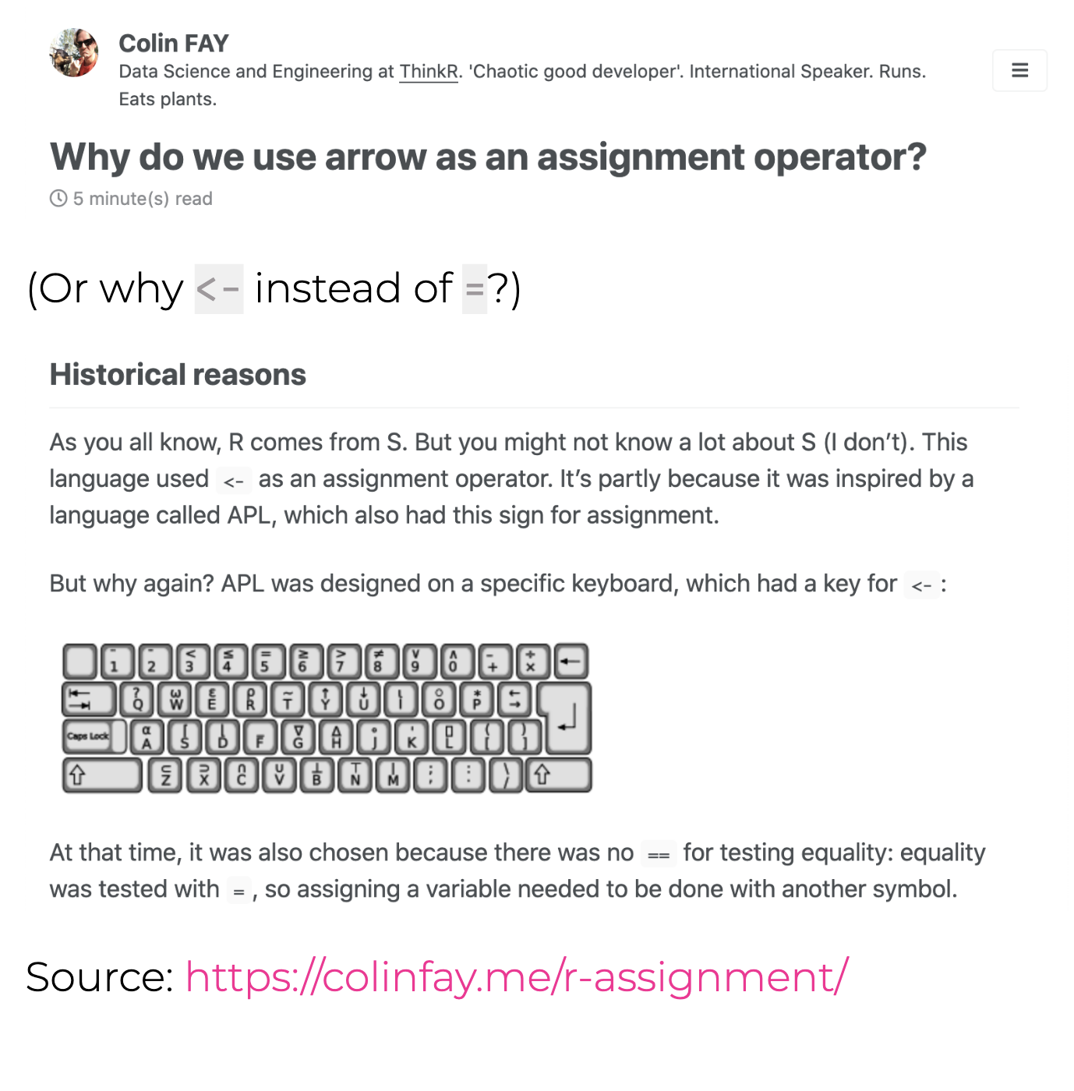

Slide 24
R History
An implementation of the S programming language (created at Bell labs in 1976)
written in C, Fortran, and R itself
R was created by Ross Ihaka and Robert Gentleman (Statisticians from NZ)
R is named partly after the authors and partly as a play on the name of S
First stable beta version in 2000

Slide 25
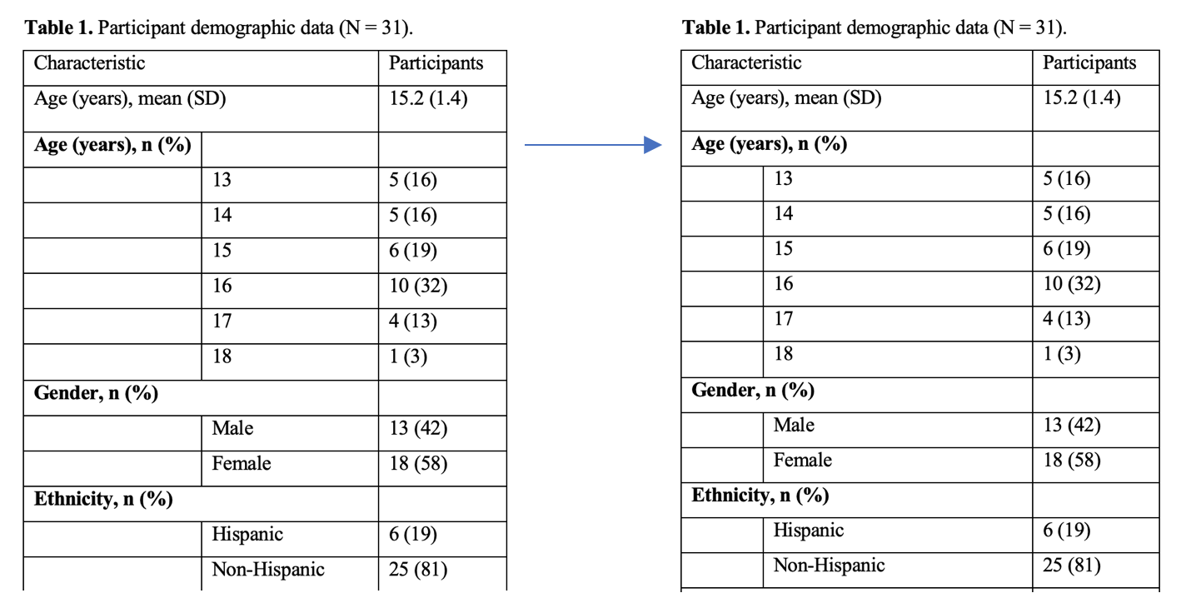
Ugly Boring Data -> Pretty, Interpretable Data

Slide 26
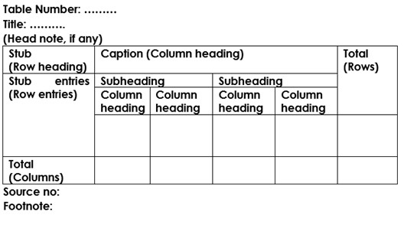
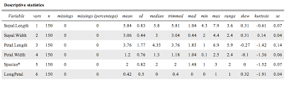

Slide 27
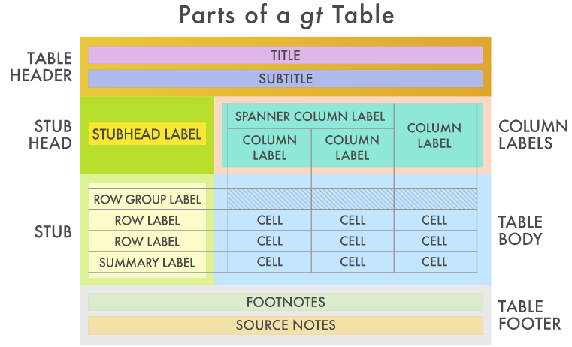

Slide 28
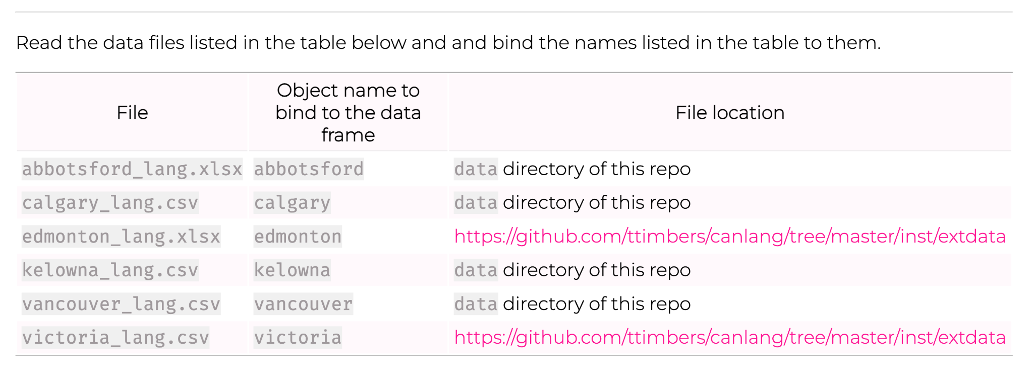
Activity

